Slide 1
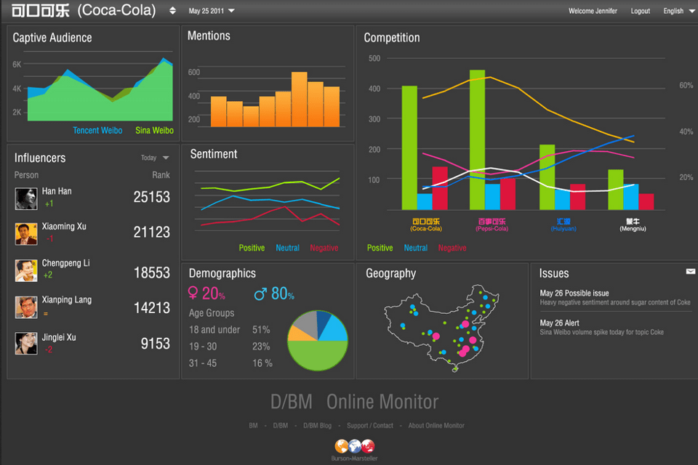
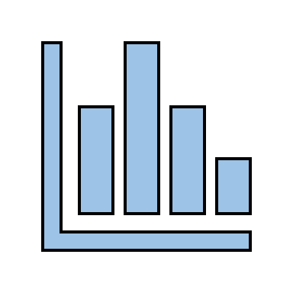




Superstore Data Analysis

Slide 2
Introduction about the PROJECT
Superstores industry comprises of companies that operate by having large size spaces which store and supply large amounts of goods. The superstore industry is comprised of extensive stores that sell a typical product line of grocery items and merchandise products, such as food, pharmaceuticals, apparel, games and toys, hobby items, furniture and appliances. The analysis of such industry is of great importance as it gives insights for the sales and profits of various products. Our analysis is based on a superstore dataset for US country where the products are ordered between 2016 and 2019.

Slide 3

OBJECTIVE
Trend in profit/sales over time (years/months/quarters).
Trend in profit/sales over region (years/months/quarters).
Product (Segment/Category) with highest and lowest sales.
Forecasting future sales according to shipping date.
With this analysis, the Superstore can identify various aspects of the shopping pattern and take measures if required.

Slide 4
Introduction about the TECHNOLOGY
Tableau is data visualization software designed to make the process of presenting data more manageable. Tableau provides many different versions of their software, such as Tableau Desktop, Reader, Public, Server, and Online. For this project, we will be using Tableau Desktop. Tableau Desktop is a free version of the software.
Tableau's Applications
Tableau bridges the gap between a workforce with little or no technical skills and tasks such as:
Data visualization, Business intelligence, Data blending, Data mining, Data collaboration,
Query translation into analytics, Real-time data analysis, No-code data queries, Importing large data sets, Managing large metadata

Slide 5

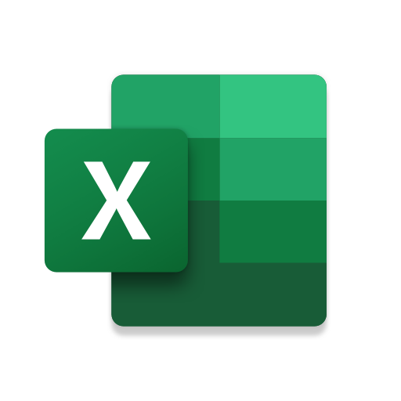
Software Requirement
Tableau Desktop
Microsoft Excel

Slide 6



Hardware Requirement
HDD
Minimum 512 GB
PC
Laptop/Desktop
RAM
Minimum 8 GB

Slide 7
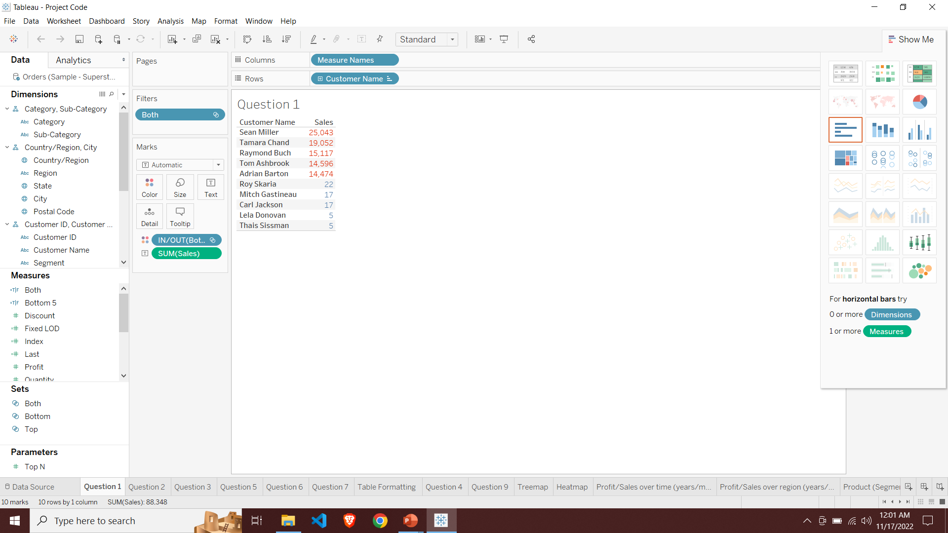
Top 5 and Bottom 5 Customer in a single sheet

Slide 8
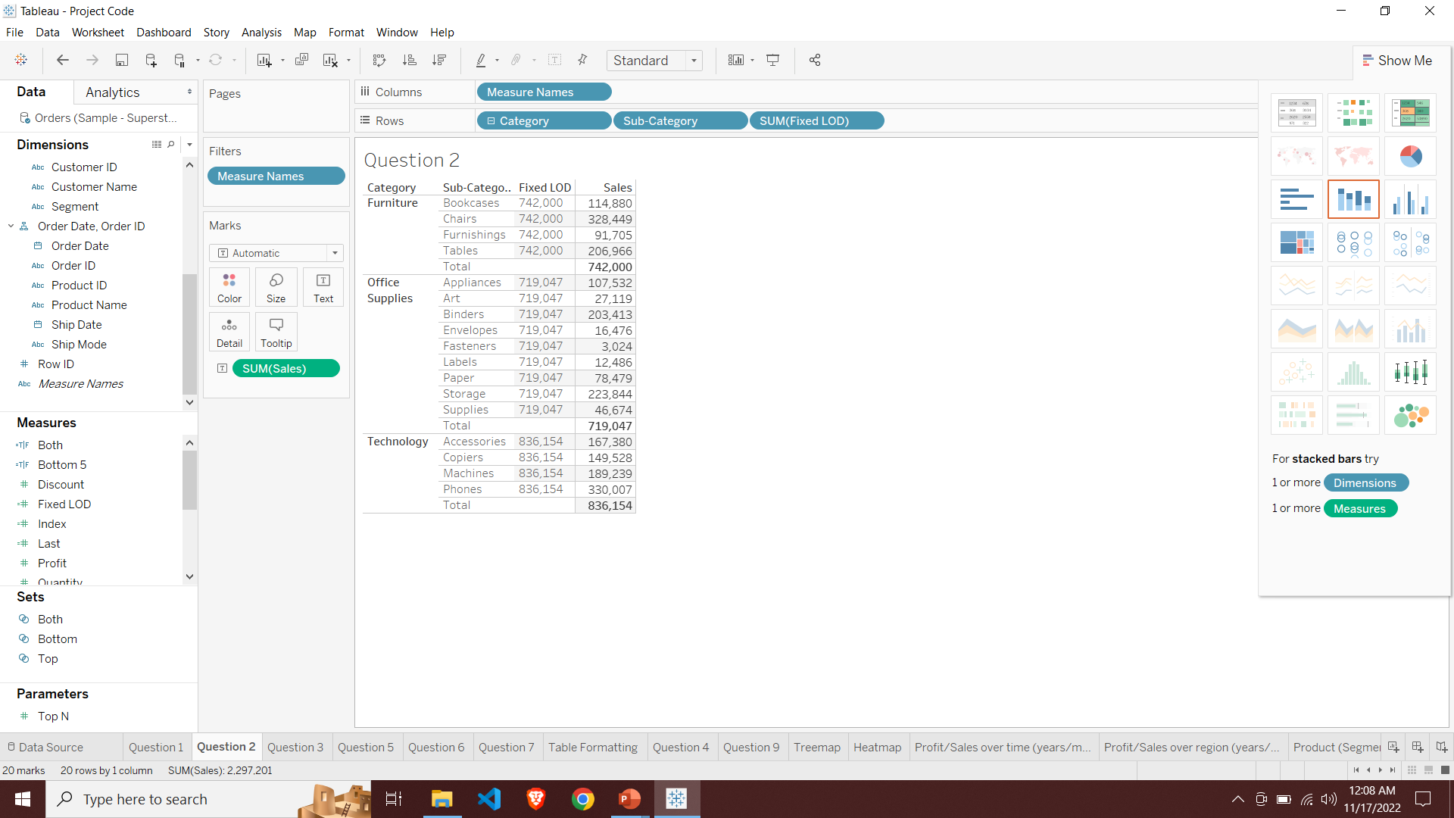
Fixed Lod to show category wise sales

Slide 9
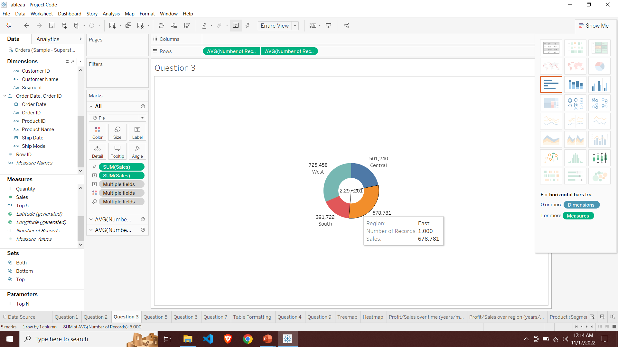
Design Dount chart

Slide 10
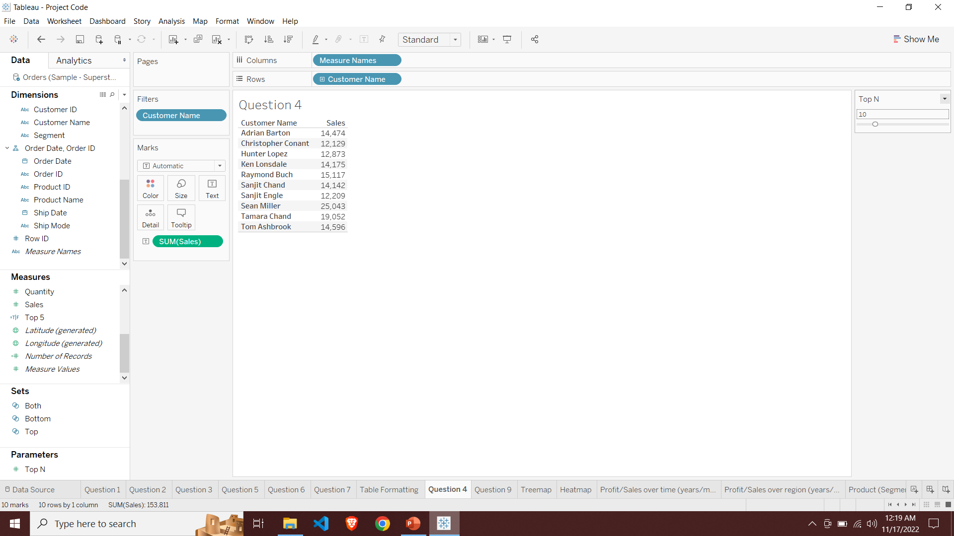
Top N Customers by sales using parameter

Slide 11
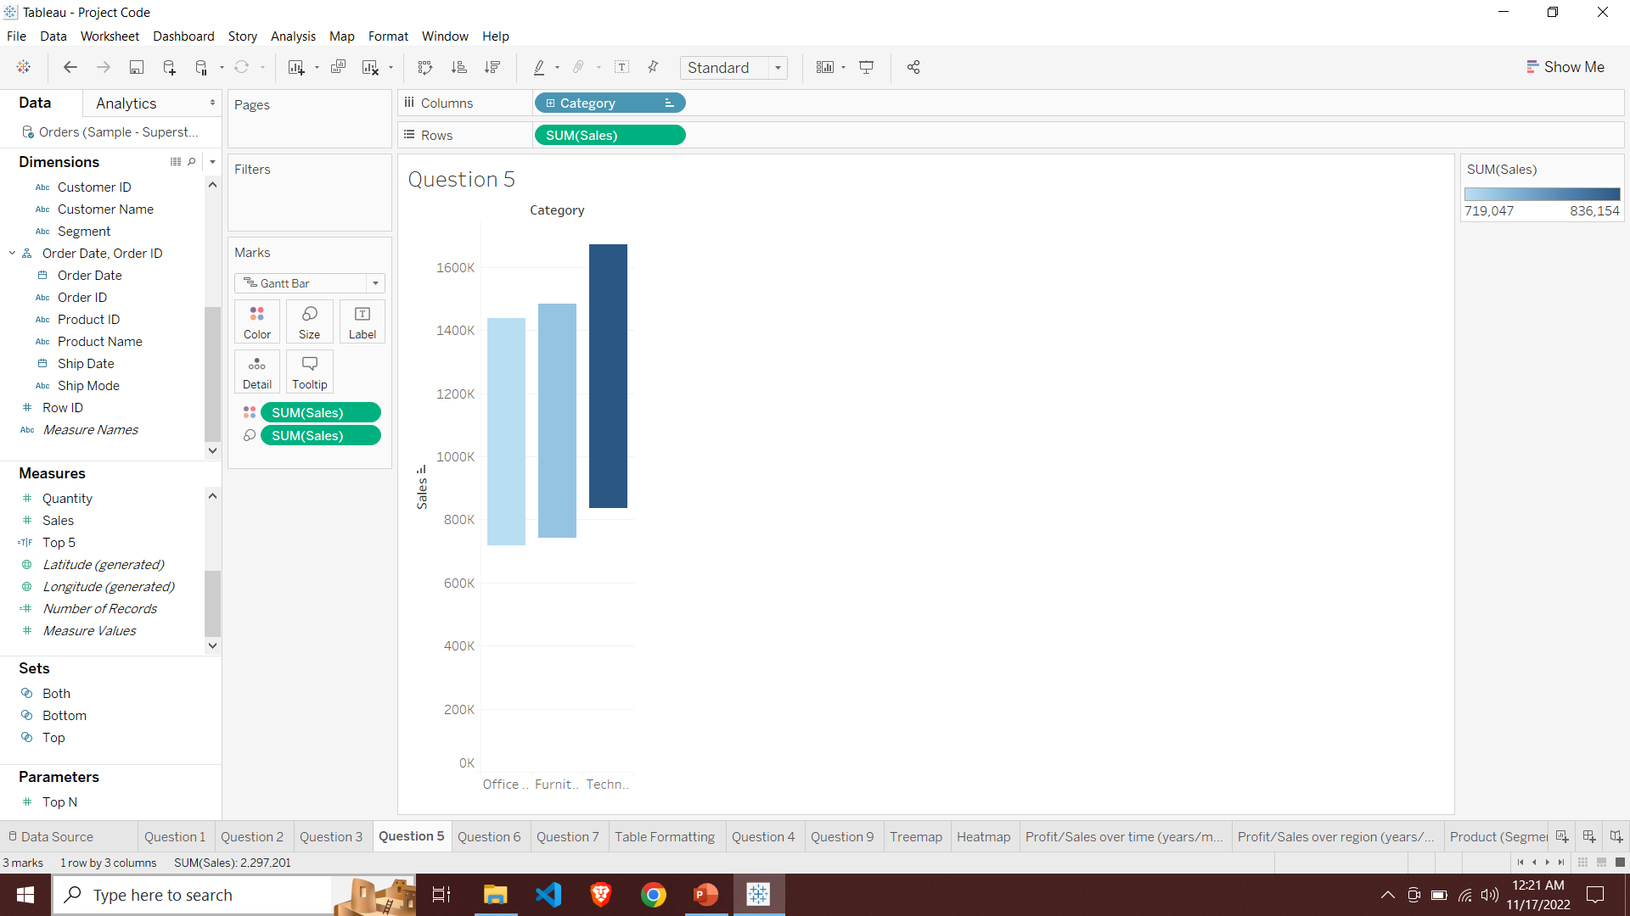
Water fall chart in tableau by using sales and category.

Slide 12
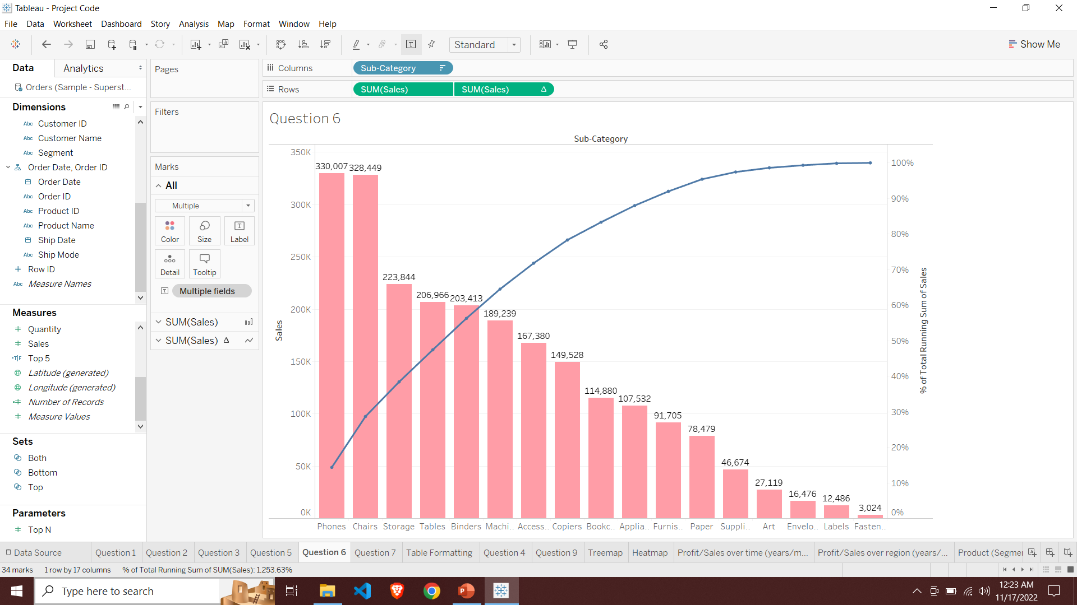
Pareto chart

Slide 13
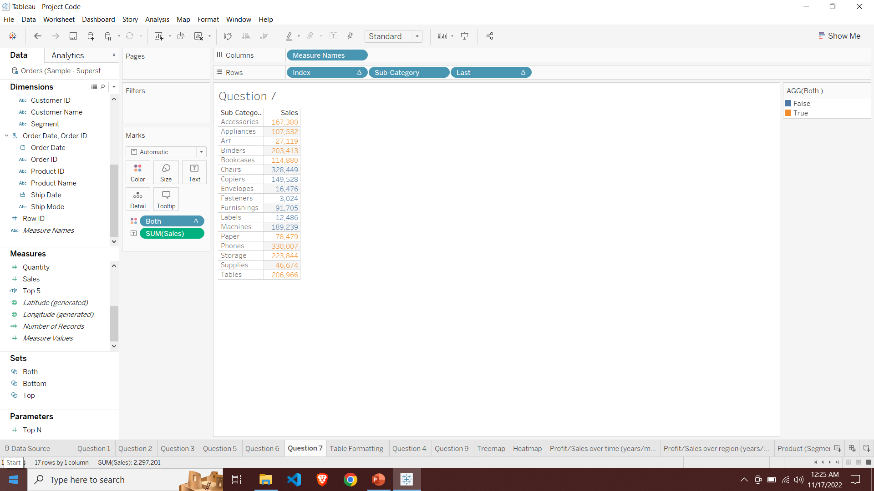
Conditional formatting

Slide 14
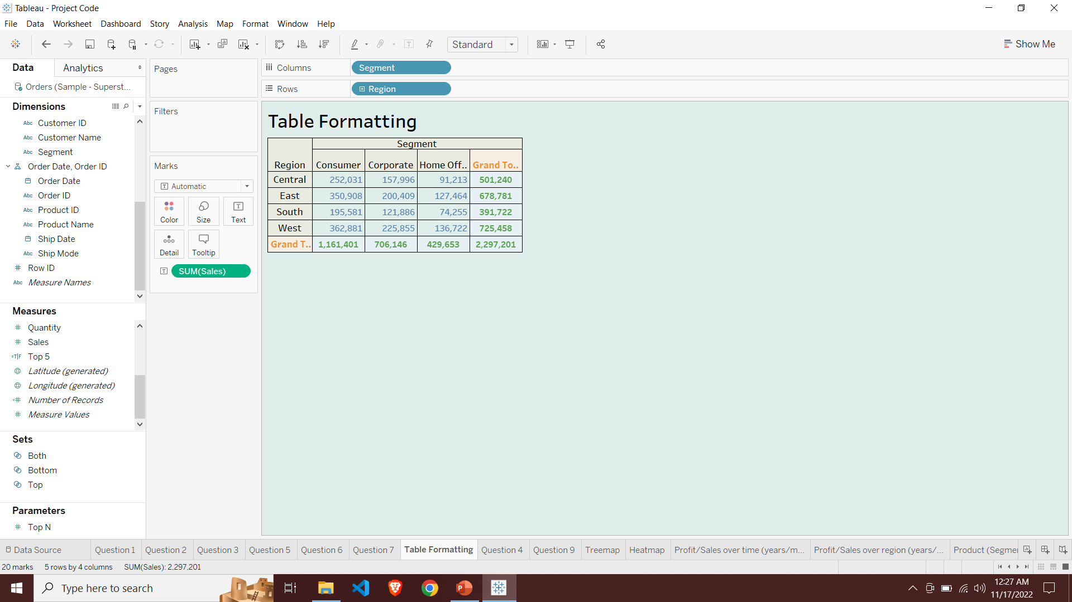
Formatting

Slide 15
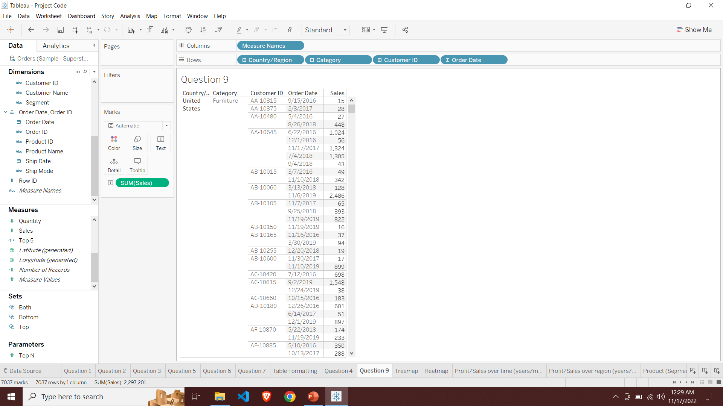
Hierarchy

Slide 16
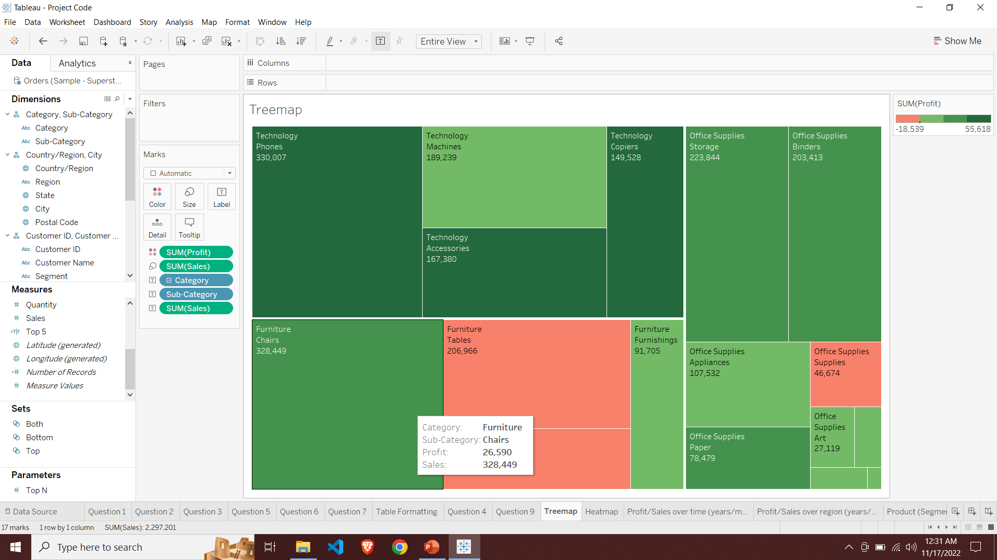
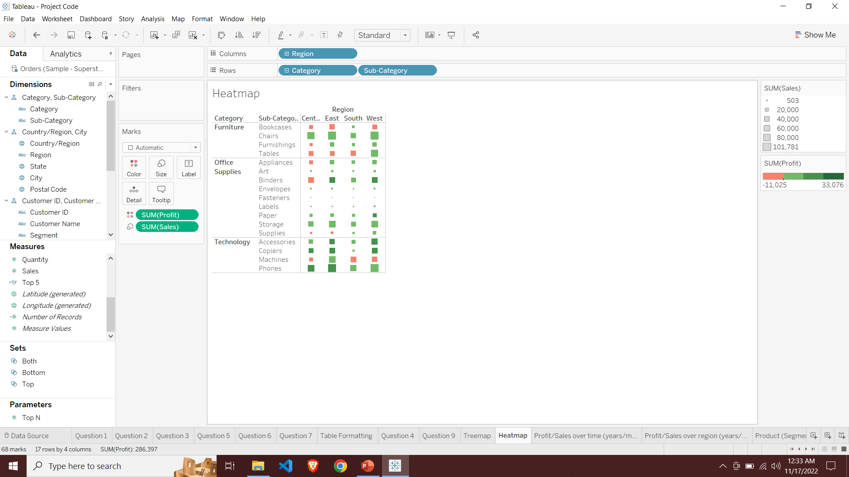
Tree Map and Heat Map

Slide 17
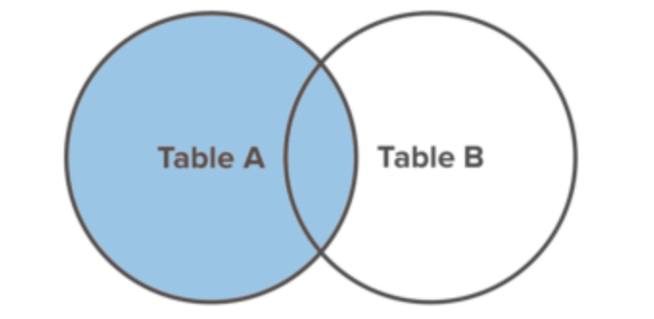
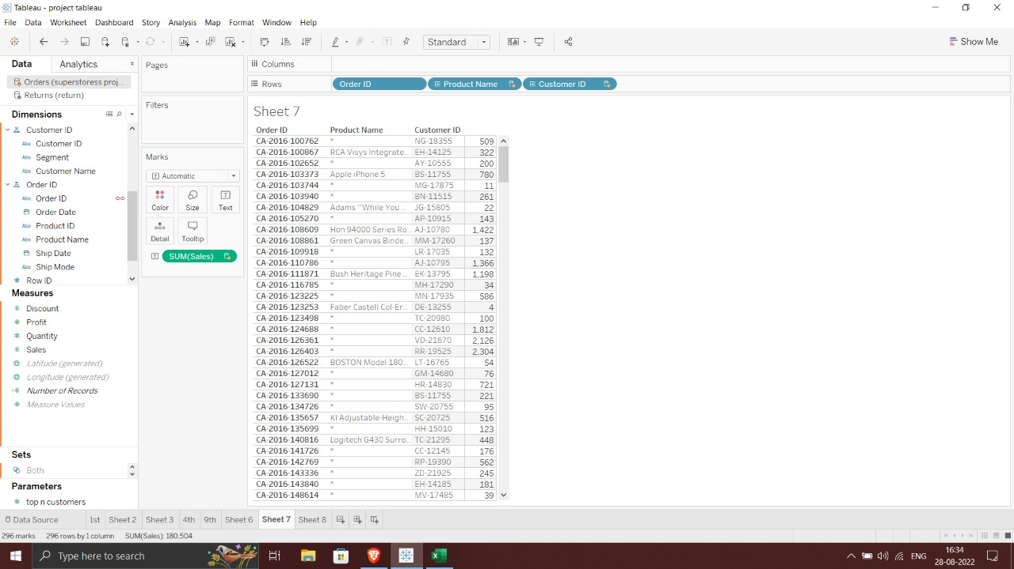
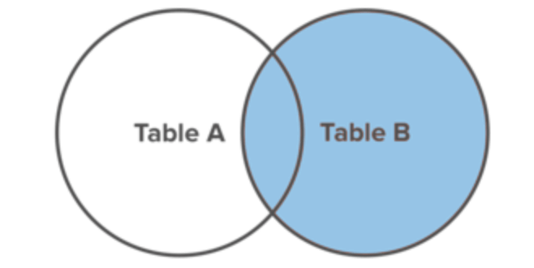
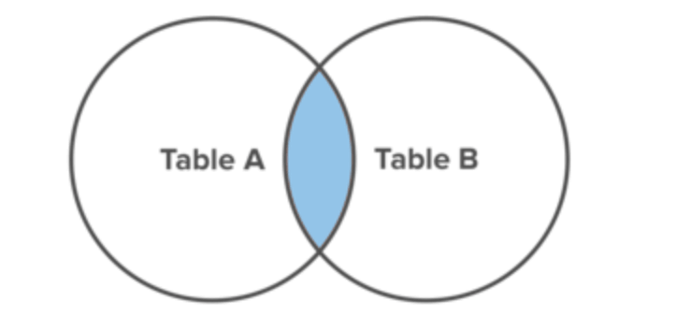
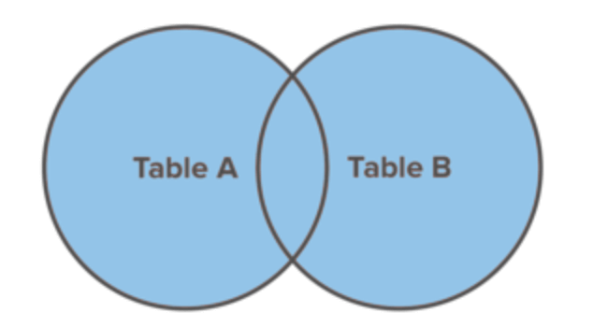
Joining and Blending

Slide 18
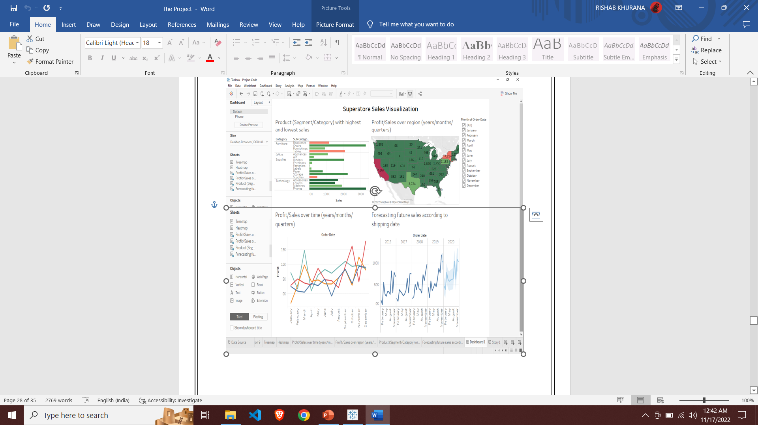
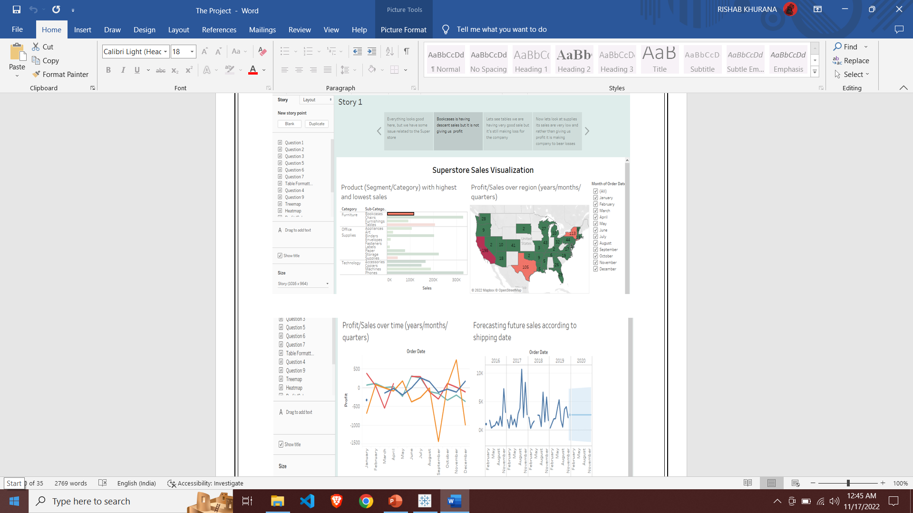
Dashboard and Story Point

Slide 19
Black Box Testing
Black Box Testing is a software testing method in which the functionalities of software applications are tested without having knowledge of internal code structure, implementation details and internal paths. Black Box Testing mainly focuses on input and output of software applications and it is entirely based on software requirements and specifications. It is also known as Behavioural Testing.
Types of Black Box Testing
There are many types of Black Box Testing but the following are the prominent ones –
Functional testing – This black box testing type is related to the functional requirements of a system; it is done by software testers.
Non-functional testing – This type of black box testing is not related to testing of specific functionality, but non-functional requirements such as performance, scalability, usability.
Regression testing – Regression testing is done after code fixes, upgrades or any other system maintenance to check the new code has not affected the existing code.

Slide 20
Tools used for Black Box Testing:
Tools used for Black box testing largely depends on the type of black box testing you are doing.
For Functional/ Regression Tests you can use – QTP, Selenium
For Non-Functional Tests, you can use – LoadRunner, JMeter
Black Box Testing Techniques
Following are the prominent Test Strategy amongst the many used in Black box Testing
Equivalence Class Testing: It is used to minimize the number of possible test cases to an optimum level while maintains reasonable test coverage.
Boundary Value Testing: Boundary value testing is focused on the values at boundaries. This technique determines whether a certain range of values are acceptable by the system or not. It is very useful in reducing the number of test cases. It is most suitable for the systems where an input is within certain ranges.
Decision Table Testing: A decision table puts causes and their effects in a matrix. There is a unique combination in each column.

Slide 21

Future Scope
The future scope for our project is to analyse big data around the world and representing it in simpler form and forecasting so that the company, organization and individual can take best decision in their Interest. Our project can radically change the present business situation by capturing a large volume of data, expand business model, energize the imaginative procedures and overall growth and development of a company.

Slide 22
Bibliography/ References
https://www.youtube.com/
https://www.tutorialsduniya.com/
https://www.slideshare.net/
https://github.com/
https://www.simplilearn.com/

Slide 23


https://github.com/rishabkhurana/Tableau-Project

